Slide 1

Tenbury CE Primary Academy
Worship Crew

Slide 2
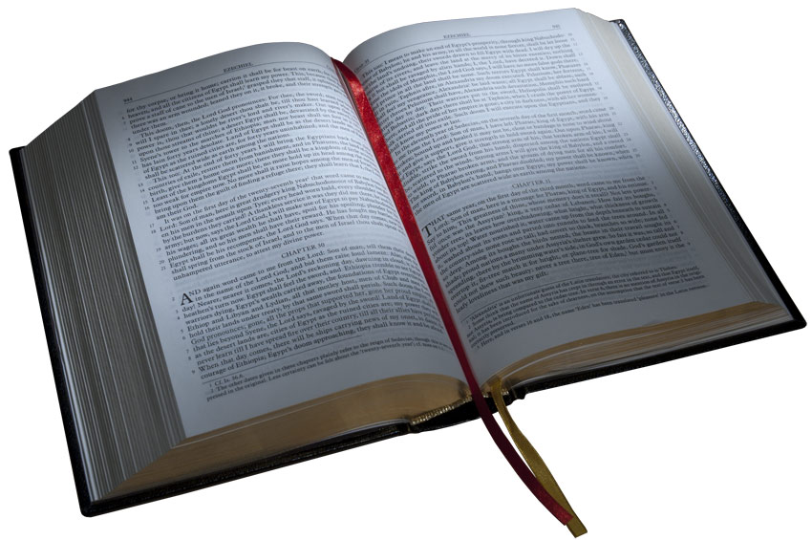



Slide 3


Select hymns appropriate for Open The Book worship each week
Select prayers that they would like to be included in weekly worship
Begin to collate a school prayer book

Slide 4

Plan and lead one act of whole school worship in the 2nd half term
Lead your class worship sometimes and encourage others in your class to do so!
Take a role in the organisation of the reflection activities and collect children’s ideas to go on the hall display and in the main Reflection Area.
Create a ‘Wonderful Worship’ book to go on display in the Reception Area, collating pictures/orders of service etc to show worship in school/church.

Slide 5
Open to all children from Y3 – Y6
We will meet on a Wednesday lunchtime at 12pm.
We have our own page on the school website
https://www.tenburyceprimary.co.uk/

Slide 6

Do you have what it takes?

