Slide 1
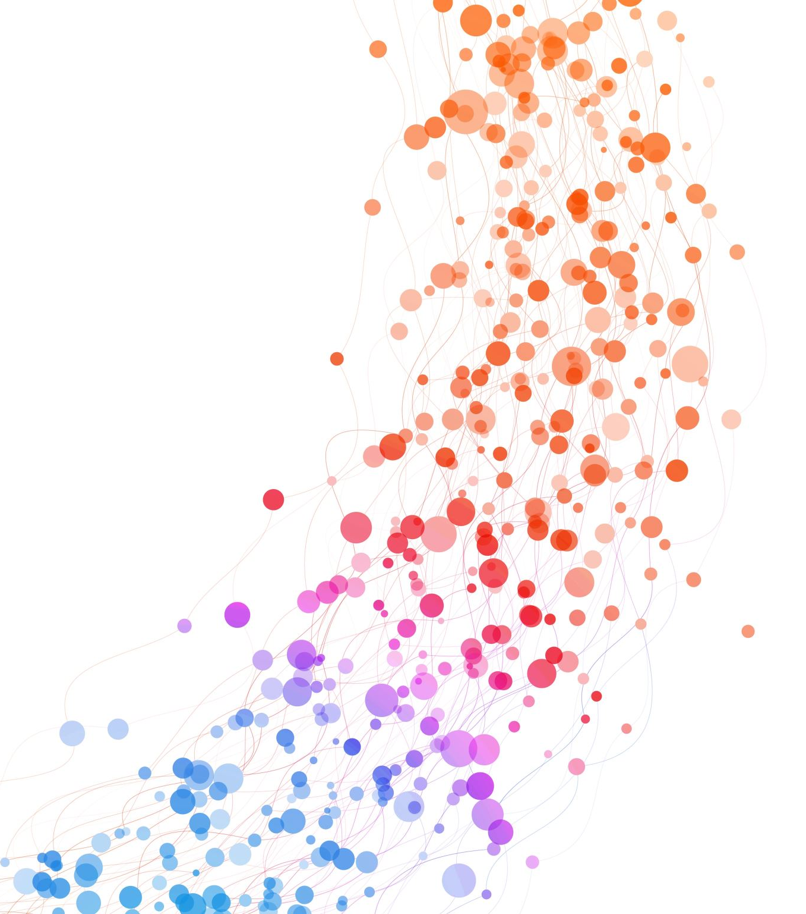

EISTEDDFOD – A FESTIVAL OF MUSIC, DANCE AND SPOKEN WORD
At St Michaels Church, Tenbury Wells
On Saturday May 9th
Sing a song you know
A dance piece no more than 3 minutes
Can you sing/ dance/ play a musical instrument?
Do you like to read poems out loud ?
If yes then we want YOU !!!
Entrants are invited for young people up to 12 years and 12-18 years to showcase their talent
This is a competition - there will be afternoon judging and then an evening concert in the church for the winners in each category
For more information and to register contact: Julie or Andrew Cook on 07807 373123 or email juliear_9@hotmail.com
Competitors MUST register to join in.
Play piano/ violin / guitar / drums / you own composition or a favourite
Write and read aloud a poem

